Slide 1
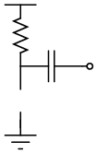



$$V_{dd}$$
$$R_{1}$$
$$C_{1}$$

Slide 2
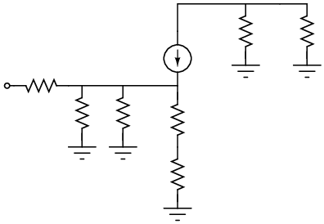









$$R_{c}$$
$$R_{L}$$
$$R_{s}$$
$${g_{m}v}_{be}$$
$$v_{s}$$
$$R_{B_{1}}$$
$$R_{B_{2}}$$
$$r_{e}$$
$$R_{E}$$

Slide 3
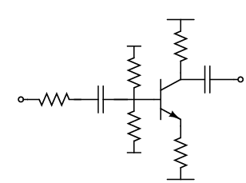











$$V_{CC}$$
$$V_{CC}$$
$$R_{C}$$
$$C_{2}$$
$$C_{1}$$
$$R_{B_{1}}$$
$$R_{s}$$
$$V_{out}$$
$$V_{in}$$
$$Q_{1}$$
$$R_{B_{2}}$$
$$R_{E}$$
$${−V}_{EE}$$
$${−V}_{EE}$$

Slide 4
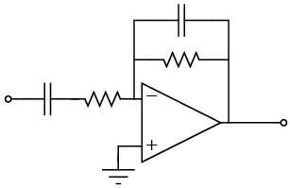


$$C_{2}$$
$$R_{2}$$
$$C_{1}$$
$$R_{1}$$
$$V_{in}$$
$$V_{out}$$

Slide 5
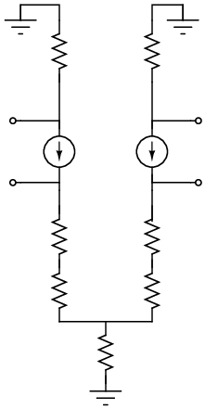













$$R_{C_{1}}$$
$$R_{C_{2}}$$
$$V_{c_{1}}$$
$$V_{c_{2}}$$
α${ i}_{e_{1}}$
α${ i}_{e_{2}}$
$$+\frac{V_{i_{d}}}{2}$$
$$−\frac{V_{i_{d}}}{2}$$
$$r_{E_{1}}$$
$$r_{E_{2}}$$
$$R_{E_{1}}$$
$$R_{E_{2}}$$
$$R_{EE}$$

Slide 6



$$R_{C_{1}}$$
$$R_{C_{2}}$$
$$V_{c_{1}}$$
$$V_{c_{2}}$$
α${ i}_{e_{1}}$
α${ i}_{e_{2}}$
$$V_{i_{C}}$$
$$V_{i_{C}}$$
$${ i}_{e_{1}}$$
$$r_{E_{1}}$$
$$r_{E_{2}}$$
$${ i}_{e_{2}}$$
$$R_{E_{1}}$$
$$R_{E_{2}}$$
$$R_{EE}$$

Slide 7
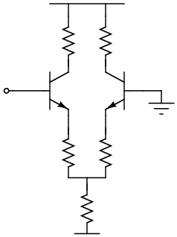







$$V_{CC}$$
$$R_{C_{1}}$$
$$R_{C_{2}}$$
$$V_{in}$$
$$Q_{1}$$
$$Q_{2}$$
$$R_{E_{1}}$$
$$R_{E_{2}}$$
$$R_{EE}$$
$${−V}_{EE}$$

Slide 8
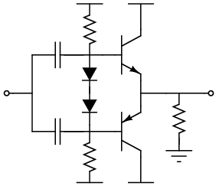


$$V_{CC}$$
$$V_{CC}$$
$$C_{1}$$
$$R_{1}$$
$$Q_{1}$$
$$V_{in}$$
$$V_{out}$$
$$C_{2}$$
$$R_{1}$$
$$Q_{2}$$
$$R_{1}$$
$${−V}_{EE}$$
$${−V}_{EE}$$

Slide 9
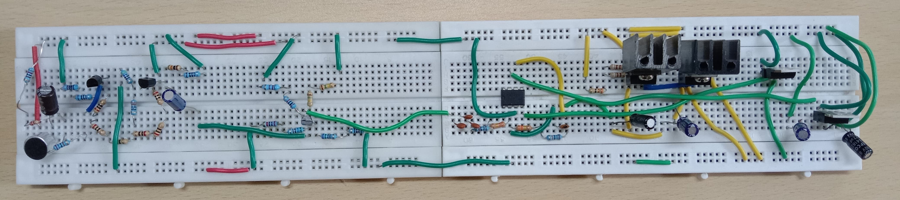
Mic Circuit
Pre-Amp Stage
Gain Stage
Filter Stage
Power-Amp Stage
Voltage Regulator
Direct Vdd
Regulated Vdd
Common Gnd
Regulated -Vee

